Slide 1

Prospects for Full Employment
Conference on Employment Growth – on a Road to Recovery
Sarajevo – July 1, 2014
Garry Jacobs
Chief Executive Officer, World Academy of Art & Science
Vice President, The Mother’s Service Society, India

Slide 2
Multi-dimensional Challenges in BiH
Transition to democracy & market economy
Breakup of Yugoslavia
Regional and civil war
Global financial crises
Eurozone crisis
Expansion of the EU
Floods

Slide 3
Convert crisis into Opportunity
Notes:
Bata Shoes
American banking
Green Revolution

Slide 4
Challenges to full employment
Population
Technology
Globalization
Working women

Slide 5
Population & Employment 1950-2012
Notes:
The figure depicts global changes in population, working age population and employment from 1950 to 2012.
Employment 2012 data taken from http://www.ilo.org/wcmsp5/groups/public/---dgreports/---dcomm/---publ/documents/publication/wcms_202326.pdf
Population data taken from United Nations, Department of Economic and Social Affairs, Population Division, World Population Prospects. http://data.un.org/

Slide 6
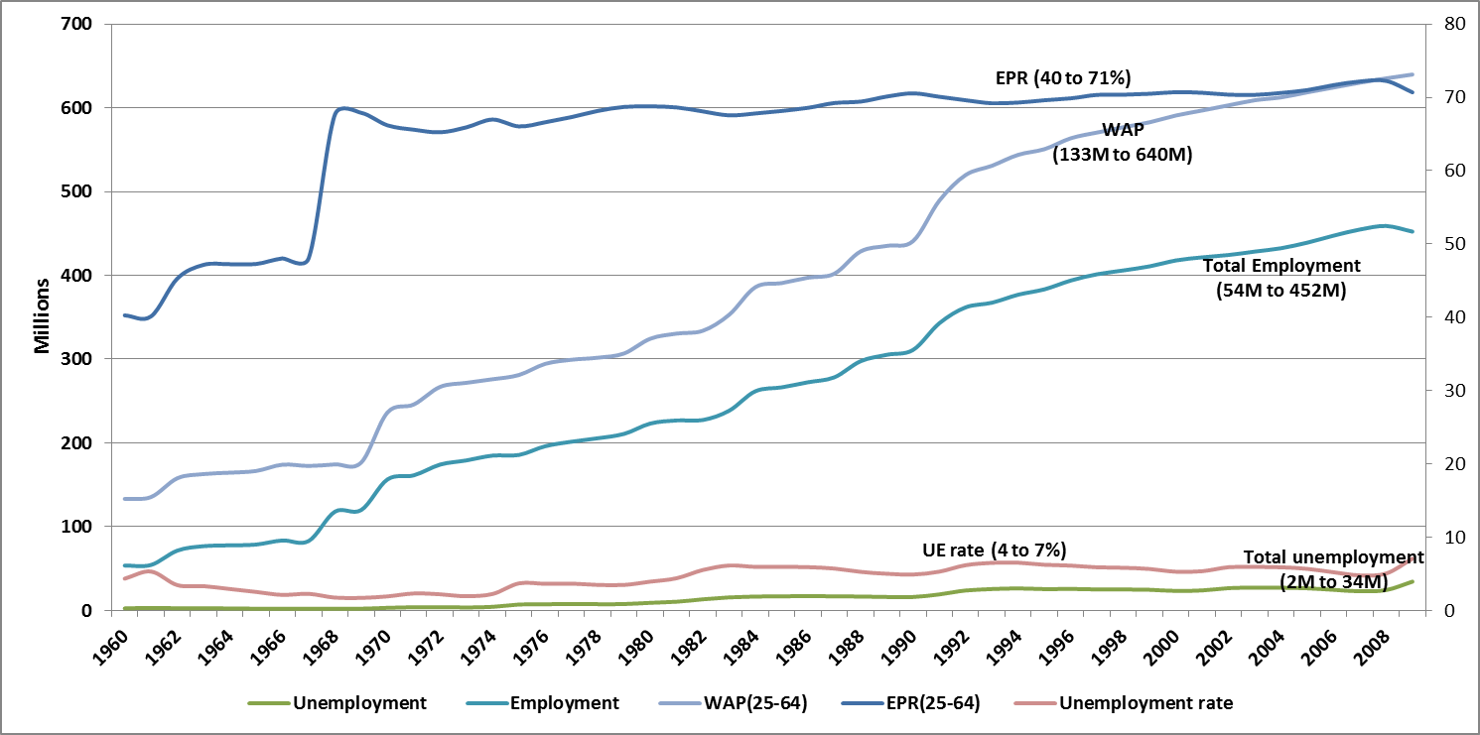
OECD Employment 1960-2008
Notes:
Figure 5 shows the employment performance of OECD countries over the past five decades. Since 1960 the working age population has grown four-fold, while the EPR for age 25-64 has risen from 40% to 72%, reflecting the large-scale induction of women into the work force. More people are working than ever before, but in absolute numbers more people are unemployed, because the population is larger and a higher proportion of the population seeks jobs. From 1997-2007, the EPR for OECD countries actually rose slightly, while unemployment fell from an average of 7.8% to 6.4%. These broad trends mask considerable differences in the performance of individual OECD countries in 2009. The EPR (25-64) ranges from a high of 83% in Iceland and Switzerland to a low of 49% in Turkey and 64% in Hungary and Italy. The adult unemployment rate ranges from a high of 16% in Spain and 12% in Estonia and Turkey to a low of 2.2% in Norway and just over 3% in Netherlands and Korea. Youth unemployment rates vary from 38% in Spain and around 27% in Estonia, Slovak Republic and Hungary to 7.3% in Netherlands, 8.2% in Switzerland and 9.1% in Japan.
OECD Stat Extracts. Dataset: LFS by sex and age. Accessed August 14, 2008, http://stats.oecd.org/wbos/default.aspx?DatasetCode=LFS_D.
ILO Global Employment Trends, 2008. p.11.

Slide 7
Paradox of Unmet Needs & Untapped Resources
Unmet needs of 3 billion people living on incomes of less than $2.50 a day for food, clothes, housing, education, medical care.
World is a-flood with unutilized and underutilized resources.
  Daily $4-5 trillion searches the globe for speculative returns
  Since 1980, global financial assets have risen from $12 trillion to 225 trillion, while real incomes grew just 2.7 fold.
  200+ million people are unemployed – 40% youth
  Billion+ involuntarily underemployed.
  Only a fraction of the world’s intellectual, technological and organizational resources harnessed for productive purposes.
This incalculable waste of Human Capital underlines the fallacy of current theory and policies.
Notes:
Wray, Randall. "Full Employment Through Direct Job Creation”, webcast presentation to the World Academy of Art & Science, November 10. 2009, Accessed October 4, 2010, http://www.worldacademy.org/files/Job%20Guarantee%20Wray%20presentation%20on%20Nov%2010%2009.pdf.

Slide 8
Goal for Full Employment in BiH
Create 600,000 new jobs
  Equivalent to reducing global unemployment by 0.3%
  In 1992 India adopted a strategy to create 100 million jobs in 10 years and is now creating about 12 million annually
Notes:
India created 1 million new jobs with STD booths
McKinsey projects
Surplus of 93 million low-skilled workers, 35 million in OECD
Shortage of 85 million high & medium skilled workers, 18 million in OECD countries (McKinsey)

Slide 9
Graded Strategies
Societal – energize human interactions
Political -- commit to comprehensive national program
Human Capital – expand education, training & apprenticeship
Social Capital – strengthen social systems & institutions
Monetary – create money for commerce & employment
Entrepreneurial – promote start-ups, support enterprise
Legal – create conducive judicial environment
Administrative – streamline policies & procedures
Commercial – expand markets & market access
Economic – investment for growth
Financial – stimulus programs
Notes:
Complementary Currencies
Community Colleges
Reduce drop outs
Reduce business failures
Micro credit as organizational innovation

Slide 10
Catalysts for Employment
Direct money from speculative investment into the real economy
Remove policy bias for capital-intensive investments
Improve ease of doing business
Promote entrepreneurship & reduce business failures
Accelerate decision-making & reduce bureaucratic hurdles
Promote skills development through training & apprenticeship
Educate youth for entrepreneurship & self-employment
Raise access to quality education relevant to societal needs
Disseminate catalytic information, publicize success stories
Increase speed of communication & transportation
Innovate organizationally and socially
Increase the velocity of money circulation
Promote regional integration of markets
Increase freedom of action and social harmony

Slide 11
Conclusions
Full employment is essential for social stability, economic security and social development
The multiple challenges confronting BiH today can be converted into opportunities for quantum leap
Full employment in BiH is an achievable goal
Full employment can be achieved by comprehensive, integrated, human-centered approach encompassing financial, economic, commercial, administrative, legal, entrepreneurial, monetary, social and human capital, political and societal strategies

Slide 13
Specific Recommendations
Consulting services to improve business performance & reduce business failures
Internet-based self-employment
Job exchanges
Community colleges
On-line education
Skills development exchanges to reduce skills gap
Raise the mandatory minimum level of education
Reduce school drop outs
Agricultural extension to raise productivity
Complementary Currencies
Promote complementary regional cooperation
Cultivate overseas Bosnians as an asset & opportunity

